Slide 1


Bank of Baroda Hackathon - 2022
Technology Partner
Your Team Name : THE HANGOVER
Your team bio :
Date : 19 . 09. 2022
LEARNING NEVER EXHAUSTS YOUR MIND!!!

Slide 2
VIDEO ANALYTICS

Slide 3
Problem Statement?
Why did you decide to solve this Problem statement?
Most of the banks use human resources for the premises surveillance.
Unfortunately it has not done efficiently that challenges the robustness of a banking system
Improper security aspects influence the illegal activities which in turn lead to a great financial loss to the organization.
By utilising their current surveillance networks to allow security to respond to events as they occur and search and filter video to speed post-event investigations, video analytics software enables banks and financial institutions to boost safety and situational awareness. With visibility into behavioural trends and foot traffic across bank branches, finance organisations can extend the value of video to operational and marketing business units by aggregating video-generated data. This will enable them to make data-driven decisions about how to improve customer service, building layouts, and security procedures.

Slide 4
Azure tools or resources
Azure tools or resources which are likely to be used by you for the prototype, if your idea gets selected?? → Computer Vision API is part of the Cognitive Services suite and is used to retrieve information about each image. → Azure Functions provides the back-end API for the web application. This platform also provides event processing for uploaded images. → Azure Event Grid triggers an event when a new image is uploaded to blob storage. The image is then processed with Azure functions. → Azure Blob Storage stores all of the image files that are uploaded into the web application, as well any static files that the web application consumes. → Azure Cosmos DB stores metadata about each image that is uploaded, including the results of the processing from Computer Vision API.

Slide 5
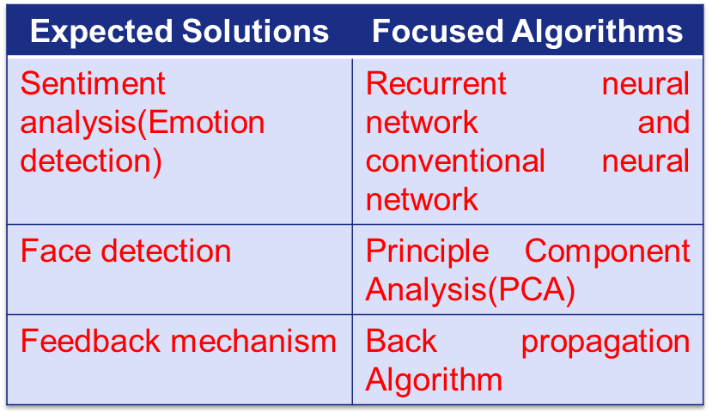
Any Supporting Functional Documents
Present your solution, talk about methodology, architecture & scalability
Objectives of the proposed solution:
Recognize the number of persons
Detection of a human
Detection of facial expression
Algorithms focused in the proposed method
The proposed model is scalable.
Hence the additional updates to the existing model could be easily done.
As it uses machine learning and deep learning concepts, it can precisely work and bring out accurate results and
the proposed prototype is expected to be trained by itself for various cases.

Slide 6
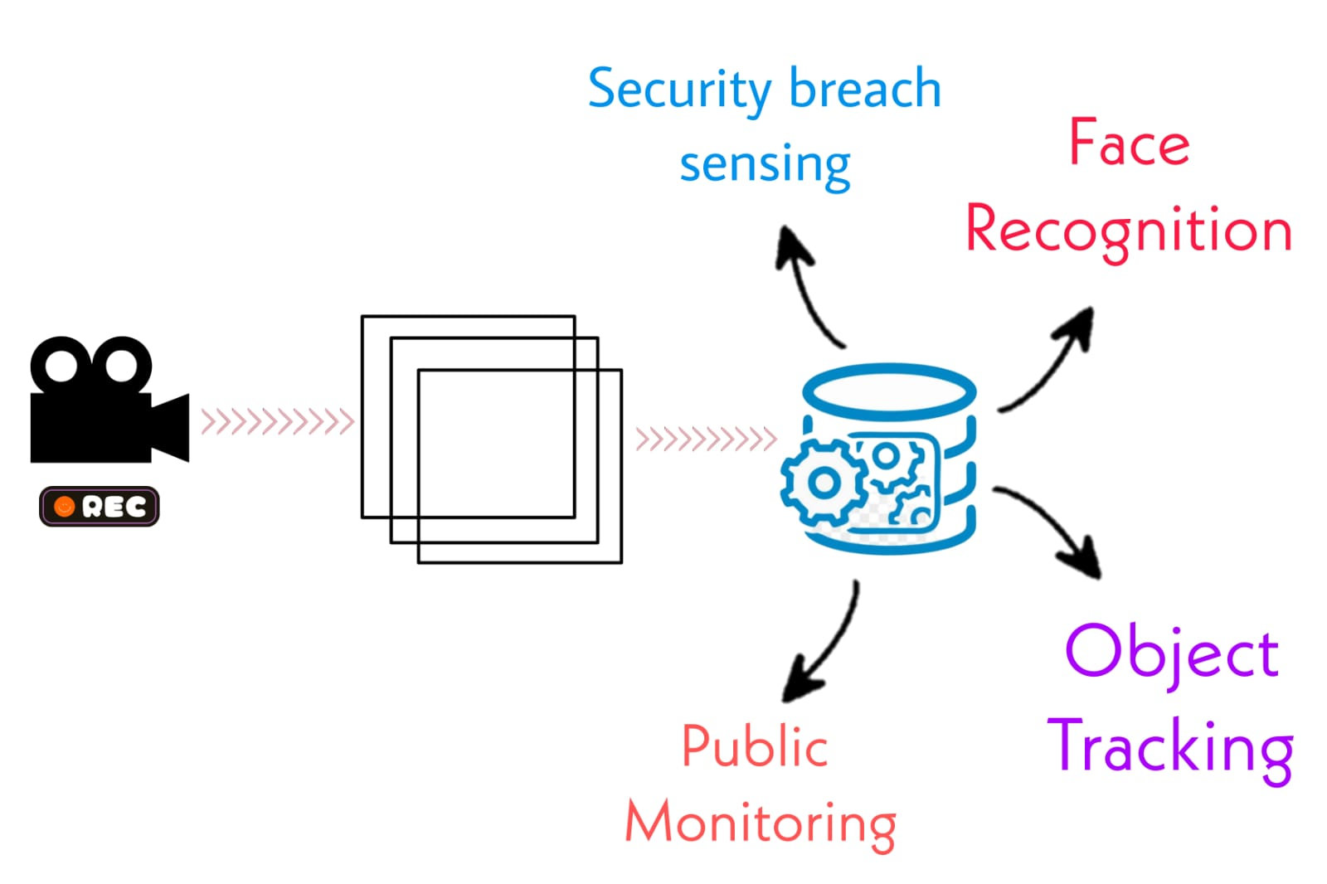
GitHub Repository Link & supporting diagrams, screenshots, if any
GitHub Repository Link : https://github.com/prithvi-17/video-analytics

Slide 7
Thank You
Team member names:
PRITHVIRAJ
SAKTHI SAIRAM
PRASSANA KUMAR
MOHAMMED ASLAM

